Slide 1

Apache Spark DataFrames
CS 4981 ML Production Systems
RJ Nowling

Slide 2
Transforming Columns
Changing the type
Arithmetic Expressions
Replacing values (when)
User-defined functions (UDFs)

Slide 3
Changing the Column Type
The cast() method can be used to change the type of the column
// change from ints to doubles
val doubleSalary = df("salary").cast("double")
val doubleBonus = df("bonus").cast("double")

Slide 4
Adding or Overwriting a Column
The withColumn(colName, col) method can be used to add or overwrite a column to a DataFrame
val df2 = df1.withColumn("salary", doubleSalary)
.withColumn("bonus", doubleBonus)

Slide 5
Arithmetic Expressions
Operations
Examples
Addition
Subtraction
Negation
Multiplication
Division
Modulo (remainder)
df("age") + 3
df("age") - 3.5
- df("velocity")
df("height") * 2.54
df("dollars") / 100.0
df("dollars") % 100.0

Slide 6
Column Arithmetic
Arithmetic expressions can be used to transform column values
// calculate bonus as a percentage of the salary
val bonusPercent = df("bonus") / df("salary") * 100
val df2 = df1.withColumn("bonus_percent_salary",
bonusPercent)

Slide 7
Resulting Schema
root
|-- employee_name: string (nullable = true)
|-- department: string (nullable = true)
|-- state: string (nullable = true)
|-- salary: double (nullable = false)
|-- age: integer (nullable = false)
|-- bonus: double (nullable = false)
|-- bonus_perent_salary: double (nullable = false)

Slide 8
Resulting Table
+-------------+----------+-----+-------+---+-------+--------------------+
|employee_name|department|state| salary|age| bonus|bonus_percent_salary|
+-------------+----------+-----+-------+---+-------+--------------------+
| James| Sales| NY|90000.0| 34|10000.0| 11.11111111111111|
| Michael| Sales| NY|86000.0| 56|20000.0| 23.25581395348837|
| Robert| Sales| CA|81000.0| 30|23000.0| 28.39506172839506|
| Maria| Finance| CA|90000.0| 24|23000.0| 25.555555555555554|
| Raman| Finance| CA|99000.0| 40|24000.0| 24.242424242424242|
| Scott| Finance| NY|83000.0| 36|19000.0| 22.89156626506024|
| Jen| Finance| NY|79000.0| 53|15000.0| 18.9873417721519|
| Jeff| Marketing| CA|80000.0| 25|18000.0| 22.5|
| Kumar| Marketing| NY|91000.0| 50|21000.0| 23.076923076923077|
+-------------+----------+-----+-------+---+-------+--------------------+

Slide 9
Replacing Values
The when(condition, value) and otherwise(value) functions can be used to replace specific values
val genderInt = when(people("gender") === "male", 0)
.when(people("gender") === "female", 1)
.otherwise(2))

Slide 10
Replacing Values
The conditions can be be more complex Boolean expressions
val col = when(col("code") === "a" || col("code") === "d", "A")
.when(col("code") === "b" && col("amt") === "4", "B")
.otherwise("A1")

Slide 11
Map
Map operations on DataFrames are really just map operations on the Row objects in the Datasets
Part 1: transform the row values and return a tuple
val result = df.map(row =>
(row.get("employee_name").toLowercase,
row.get("department").toLowercase,
row.get("state"),
row.get("salary") * 100.0))
}

Slide 12
Map
Part 2: convert back to DataFrame
val resultDF = result.toDF(
"employee_name",
"department",
"state",
"salary")
Downside: need to restate the column names

Slide 13
User-Defined Functions (UDF)
UDF is a term from SQL
They provide a way to provide custom functions that can be called like count(), max(), min(), sum(), and other built-in functions
A UDF can be created by wrapping a Scala function using the udf() function:
val myUDF = udf(s => s.toLowercase)

Slide 14
User-Defined Functions (UDF)
The UDF can then be applied to the values in a column (a map operation) like so:
val convertedCol = myUDF(df("employee_name"))
val df2 = df.withColumn(
"employee_name",
convertedCol)

Slide 15
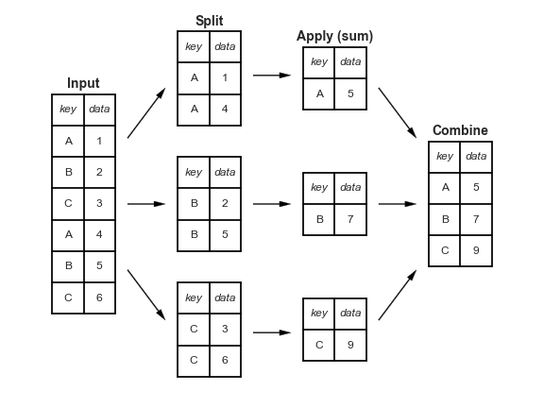
Group By and Aggregations

Slide 16
Example Dataset
+-------------+----------+-----+------+---+-----+
|employee_name|department|state|salary|age|bonus|
+-------------+----------+-----+------+---+-----+
| James| Sales| NY| 90000| 34|10000|
| Michael| Sales| NY| 86000| 56|20000|
| Robert| Sales| CA| 81000| 30|23000|
| Maria| Finance| CA| 90000| 24|23000|
| Raman| Finance| CA| 99000| 40|24000|
| Scott| Finance| NY| 83000| 36|19000|
| Jen| Finance| NY| 79000| 53|15000|
| Jeff| Marketing| CA| 80000| 25|18000|
| Kumar| Marketing| NY| 91000| 50|21000|
+-------------+----------+-----+------+---+-----+

Slide 17
Group By and Aggregation Syntax
The group by API starts with calling groupBy() on a DataFrame followed by the operations to perform on the groups
groupBy(col1: String, cols: String*)
groupBy(cols: Column*)
df.groupBy("department")
df.groupBy("state")
df.groupBy(df("state"), df("department"))

Slide 18
Group By Operations
avg(colNames: String*): Compute the average of values in each column for each group
count(): Count the number of rows in each group
max(colNames: String*): Compute the maximum value in each column for each group
mean(colNames: String*): Compute the average of values in each column for each group
min(colNames: String*): Compute the minimum value in each column for each group
sum(colNames: String*): Compute the sum in each column for each group

Slide 19
Group By and Aggregation Examples
df.groupBy("department")
.mean("salary")
+----------+---------+
|department| salary|
+----------+---------+
| Sales| 85666.67|
| Finance| 87750.0|
| Marketing| 85500.0|
+----------+---------+

Slide 20
Group By and Aggregation Examples
df.groupBy("department")
.sum("bonus")
+----------+----------+
|department| bonus|
+----------+----------+
| Sales| 53000 |
| Finance| 81000 |
| Marketing| 39000 |
+----------+----------+

Slide 21
Joins
Data may be stored in multiple tables
For example, for a housing data set:
Real estate listings with cities and zip codes
Table of GPS coordinates for each city and/or zip code
List of schools by city, with a rating for each
Crime rates by city or zip code
We can use a "join" operation to match rows from a pair of tables to form a new table

Slide 22
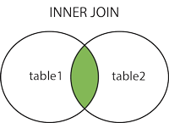
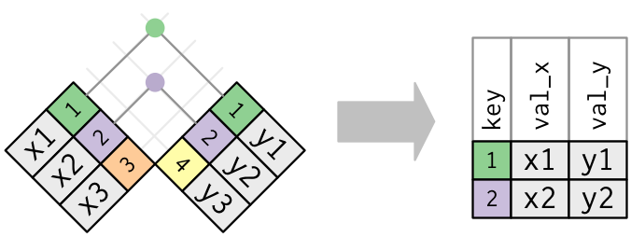
Inner Joins

Slide 23
Join Syntax
There are multiple methods for performing joins. We describe the most generic
join(right: Dataset,
joinExprs: Column,
joinType: String)

Slide 24
Example Data Sets
root
|-- employee_name: string
|-- department: string
|-- state: string
|-- salary: double
|-- age: integer
|-- bonus: double
root
|-- state: string
|-- income_tax: double

Slide 25
Inner Join Example
val joined = df1.join(df2,
df1("state") === df2("state"),
"inner")

Slide 26
Inner Join Example
+-------------+----------+-----+------+---+-----+----------+
|employee_name|department|state|salary|age|bonus|income_tax|
+-------------+----------+-----+------+---+-----+----------+
| James| Sales| NY| 90000| 34|10000| 0.10 |
| Michael| Sales| NY| 86000| 56|20000| 0.10 |
| Robert| Sales| CA| 81000| 30|23000| 0.15 |
| Maria| Finance| CA| 90000| 24|23000| 0.15 |
| Raman| Finance| CA| 99000| 40|24000| 0.15 |
| Scott| Finance| NY| 83000| 36|19000| 0.10 |
| Jen| Finance| NY| 79000| 53|15000| 0.10 |
| Jeff| Marketing| CA| 80000| 25|18000| 0.15 |
| Kumar| Marketing| NY| 91000| 50|21000| 0.10 |
+-------------+----------+-----+------+---+-----+----------+

Slide 27
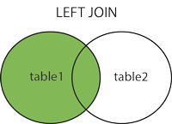
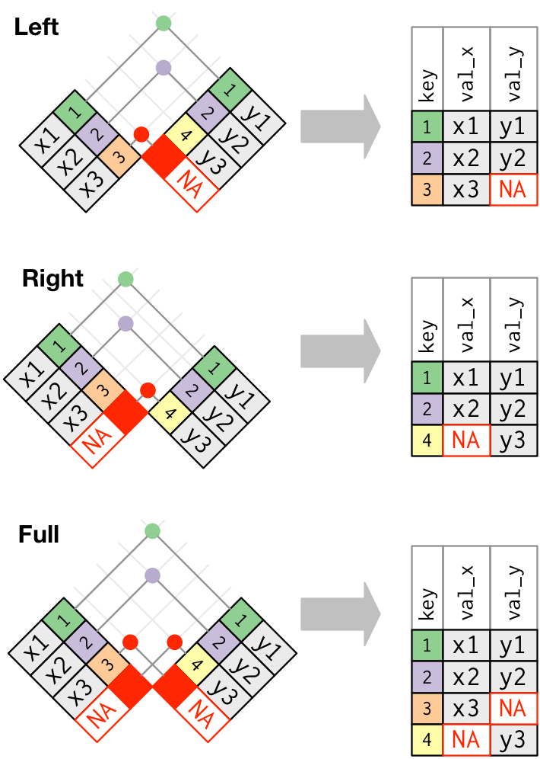
Left Outer Join

Slide 28
Left Outer Join Example
val joined = df1.join(df2,
df1("state") === df2("state"),
"left_outer")

Slide 29
Left Outer Join Example
+-------------+----------+-----+------+---+-----+----------+
|employee_name|department|state|salary|age|bonus|income_tax|
+-------------+----------+-----+------+---+-----+----------+
| James| Sales| FL| 90000| 34|10000| NULL |
| Michael| Sales| NY| 86000| 56|20000| 0.10 |
| Robert| Sales| CA| 81000| 30|23000| 0.15 |
| Maria| Finance| CA| 90000| 24|23000| 0.15 |
| Raman| Finance| FL| 99000| 40|24000| NULL |
| Scott| Finance| NY| 83000| 36|19000| 0.10 |
| Jen| Finance| FL| 79000| 53|15000| NULL |
| Jeff| Marketing| CA| 80000| 25|18000| 0.15 |
| Kumar| Marketing| NY| 91000| 50|21000| 0.10 |
+-------------+----------+-----+------+---+-----+----------+

Slide 30
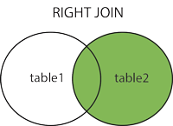
Right Outer Join

Slide 31
Right Outer Join Example
val joined = df1.join(df2,
df1("state") === df2("state"),
"right_outer")

Slide 32
Right Outer Join Example
+-------------+----------+-----+------+---+-----+----------+
|employee_name|department|state|salary|age|bonus|income_tax|
+-------------+----------+-----+------+---+-----+----------+
| Michael| Sales| NY| 86000| 56|20000| 0.10 |
| Robert| Sales| CA| 81000| 30|23000| 0.15 |
| Maria| Finance| CA| 90000| 24|23000| 0.15 |
| Scott| Finance| NY| 83000| 36|19000| 0.10 |
| Jeff| Marketing| CA| 80000| 25|18000| 0.15 |
| Kumar| Marketing| NY| 91000| 50|21000| 0.10 |
| NULL | NULL | AK| NULL| NULL| NULL| 0.12 |
| NULL | NULL | AZ| NULL| NULL| NULL| 0.13 |
+-------------+----------+-----+------+---+-----+----------+

Slide 33
Full Outer Join

Slide 34
Full Outer Join Example
val joined = df1.join(df2,
df1("state") === df2("state"),
"full_outer")

Slide 35
Full Outer Join Example
+-------------+----------+-----+------+---+-----+----------+
|employee_name|department|state|salary|age|bonus|income_tax|
+-------------+----------+-----+------+---+-----+----------+
| James| Sales| FL| 90000| 34|10000| NULL |
| Michael| Sales| NY| 86000| 56|20000| 0.10 |
| Robert| Sales| CA| 81000| 30|23000| 0.15 |
| Maria| Finance| CA| 90000| 24|23000| 0.15 |
| Raman| Finance| FL| 99000| 40|24000| NULL |
| Scott| Finance| NY| 83000| 36|19000| 0.10 |
| Jen| Finance| FL| 79000| 53|15000| NULL |
| Jeff| Marketing| CA| 80000| 25|18000| 0.15 |
| Kumar| Marketing| NY| 91000| 50|21000| 0.10 |
| NULL | NULL | AK| NULL| NULL| NULL| 0.12 |
| NULL | NULL | AZ| NULL| NULL| NULL| 0.13 |
+-------------+----------+-----+------+---+-----+----------+

Slide 36
Writing Data
DataFrames can easily be saved as
CSV files
Parquet files
JSON files with one JSON record per line
Tables in relational databases
Dataset objects have a write property containing a DataFrameWriter object
The DataFrameWriter is used for reading data

Slide 37
Example: Write CSV file
df.write
.option("header", true)
// Spark will refuse to overwrite existing
// files by default
.mode("overwrite")
.csv("/path/to/output/directory")

Slide 38
Example: Write Parquet file
df.write
// Spark will refuse to overwrite existing
// files by default
.mode("overwrite") .parquet("/path/to/output/directory")

Slide 39
Example: Write JSON file
df.write
// Spark will refuse to overwrite existing
// files by default
.mode("overwrite") .json("/path/to/output/directory")

Slide 40
Spark DataFrame Examples
https://github.com/rnowling/spark-examples/blob/main/src/main/scala/DataFrameExample2.scala
SparkBy{Examples}

